Slide 1

Project- BAT Petra
Presented By
Akash Yadav

Slide 2
Data Flow Architecture

Slide 3
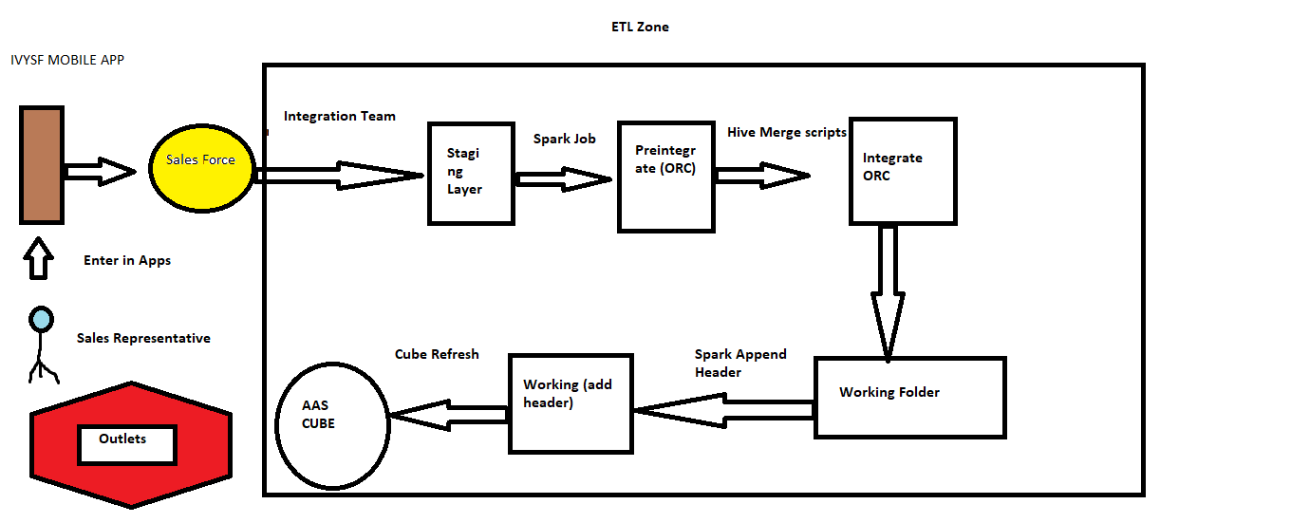

Slide 4
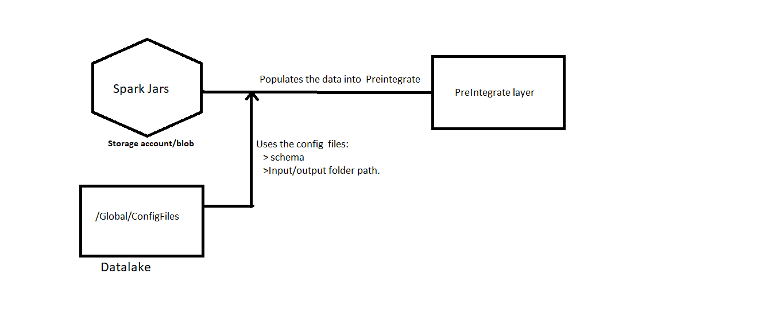
Staging to Preintegrate

Slide 5
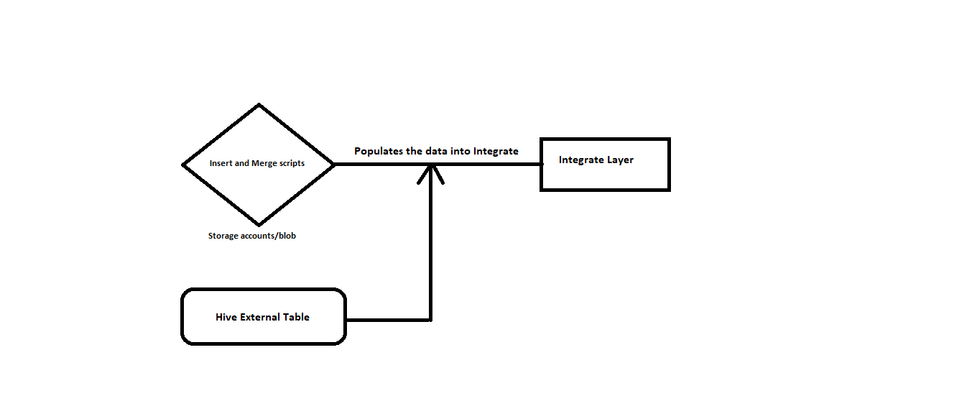
Preintegrate to Integrate

Slide 6
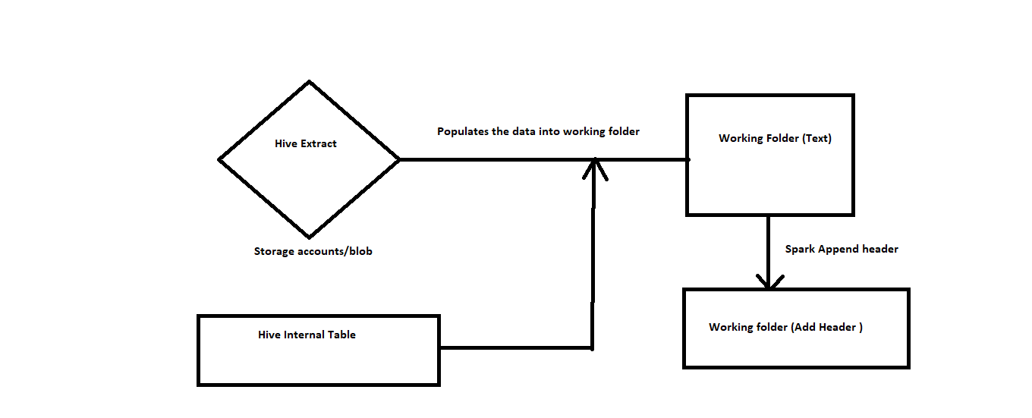
Integrate to Working Folder

Slide 7
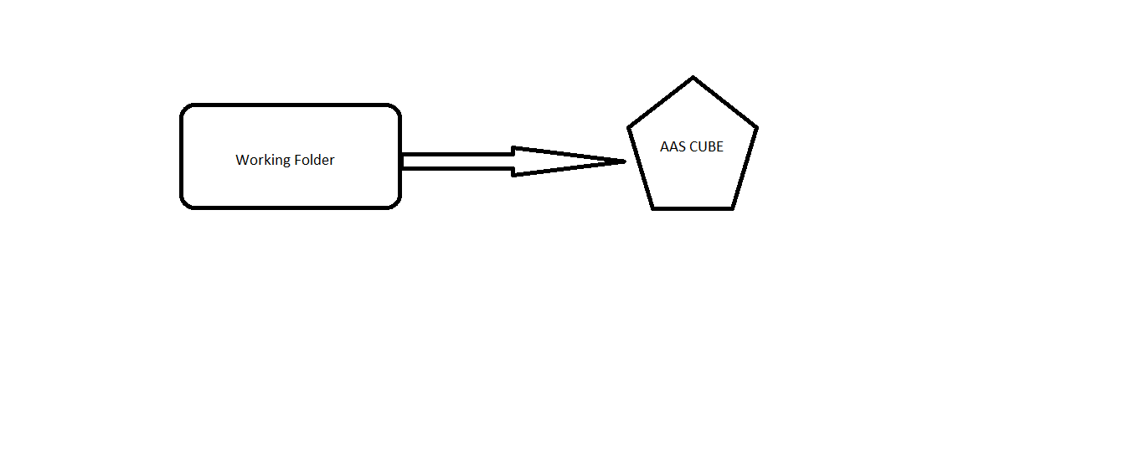
Working folder to cube Refresh

